Slide 1
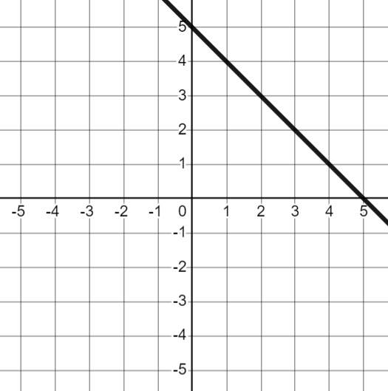
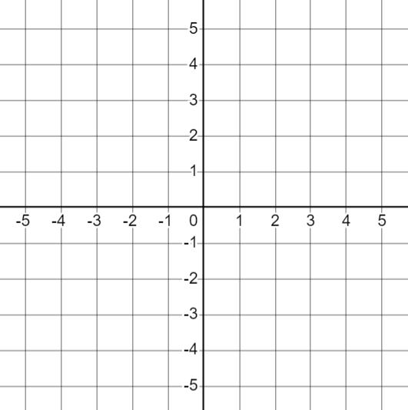
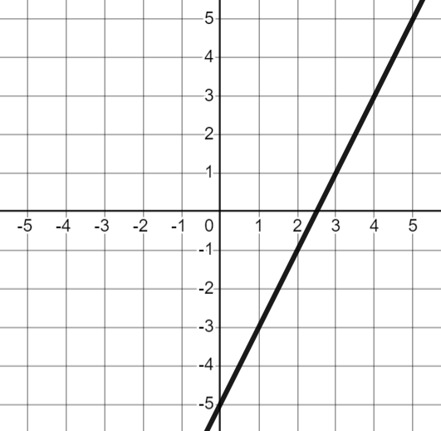
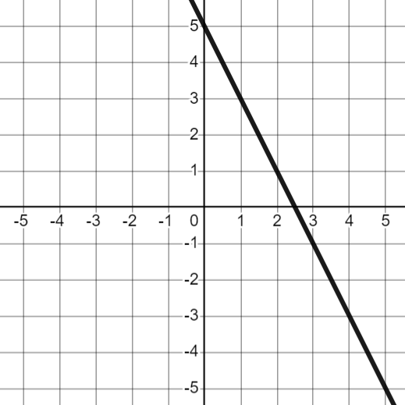


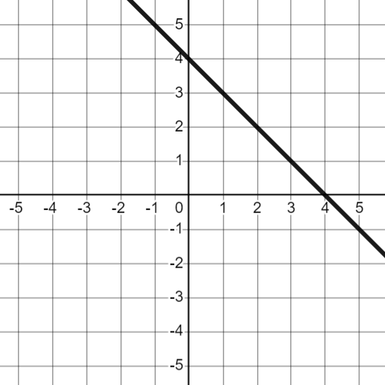
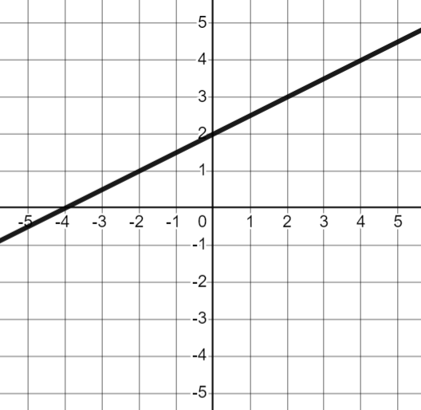
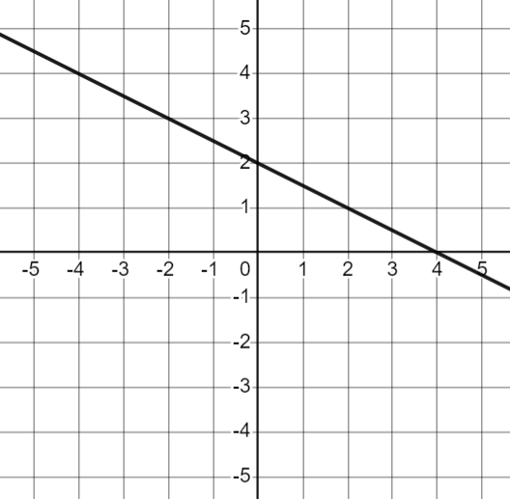

The equation of a straight line
Task A: Different forms of linear relationships
1) Plot each equation and identify the gradient and y-intercept.
x + y = 5 | b) y = 2x − 5 | c) y = 5 − 2x | d) 2x + 2y = 10
gradient = −1
y-intercept = (0, 5)
gradient = 2
y-intercept = (0, −5)
gradient = −2
y-intercept = (0, 5)
gradient = −1
y-intercept = (0, 5)
2) Match up any equations that represent the same relationship
a) and d)
3) Plot each equation and identify the gradient and y-intercept.
x + y = 4 | b) y = 4 − x | c) y = x + 2 | d) 2y + x = 4
gradient = −1
y-intercept = (0, 4)
gradient = −1
y-intercept = (0, 4)
gradient =
y-intercept = (0, 2)
gradient =
y-intercept = (0, 2)
4) Match up any equations that represent the same relationship
a) and b)

Slide 2
The equation of a straight line
Task B: Gradient and y-intercept from y = mx + c
1) Fill in the table with the gradient and y-intercept for each equation.
Write the y-intercept as a coordinate.
equation | gradient | y-intercept
a) y = 8x + 4 | 8 | (0, 4)
b) y = 3x − 7 | 3 | (0, −7)
c) y = −5x + 1 | −5 | (0, 1)
d) y = 10 − 3x | −3 | (0, 10)
e) y = x | 1 | (0, 0)
f) y = −x | −1 | (0, 0)
g) y = 5 | 0 | (0, 5)
h) y = p + (q + 3)x | q + 3 | (0, p)
2) Fill in the missing pieces of information for each question.
equation | gradient | y-intercept
a) y = 9x + 4 | 9 | (0, 4)
b) y = − 6x | −6 | (0, )
c) y = 3(4x + 2) | 12 | (0, 6)
d) y = 10 − x | −1 | (0, 10)
e) 5(1 − 2x) = y | −10 | (0, 5)
f) 8 − 5x = y | −5 | (0, 8)
g) y = u + tx | t | (0, u)
Mathematics in Education and Industry
v2.2

